Slide 1

MedFusion AI
Department of Electrical and Electronics Engineering
By
Mukund Narsaria (1032212619)
Shreerang Mhatre (1032211745)
Atharv Yadav (1032211522)
Name of Project Guide:
Dr. Prof. Netra Lokhande
Date: 7/11/2024

Slide 2
Contents:
Introduction
Motivation
Aim and Objectives
Project Description
Hardware Components
Model Analysis
Video
Tasks Completed till Date
Conclusion
References

Slide 3
Introduction:
In today's rapidly advancing world of medical science, AI is revolutionizing the field by enabling more accurate diagnostics, predictive insights, and personalized treatment recommendations. Leveraging the full spectrum of machine learning, from basic models for diabetes detection to advanced techniques like brain tumor segmentation, we have developed an innovative online platform that consolidates multiple disease detection tools in one place. This project aims to provide quick and accessible health assessments marking a significant step toward the future of AI-driven healthcare.
Department of Electrical and Electronics Engineering

Slide 4
Motivation:
In a world where timely diagnosis can make the difference between life and death, the need for accessible, accurate, and comprehensive healthcare tools has never been more urgent. The motivation behind this project stems from the growing demand for early detection and personalized care in managing critical health conditions. Traditional diagnostic methods often require multiple visits, various tests, and significant time, leading to delayed treatment and increased patient anxiety. By leveraging AI, we aim to bridge this gap by creating a platform that not only provides quick and reliable health assessments but also ensures that these tools are accessible to everyone, regardless of location or resources. This project aspires to empower individuals and healthcare providers alike, making early intervention a reality and improving patient outcomes on a global scale.

Slide 5
Aim and Objectives:
Aim: The aim is to create an AI-powered platform that consolidates the diagnosis of four critical health conditions into a single, accessible tool, providing immediate and comprehensive test results to improve patient outcomes.
Objectives:
To create a separate model for each disease using the symptoms for that disease and prediction according to related data for a particular patient.
Combining all disease detection models and creating a unified system for multi disease detection with its separate input fields.
Designing a website and deploying the system into it for web access and creating a dashboard for instant reporting.
Final deployment of the system on Raspberry Pi for portable access and secure Data Management and no need for heavy computing based servers.

Slide 6
Project Description:

Slide 7
Hardware Components:-
1. Raspberry Pi 4 Model B (4GB RAM)
Purpose: Used to host all software components and run Ubuntu as the operating system.
2. SD Card (32GB SanDisk)
Purpose: Storage for the Raspberry Pi, containing the OS and other files.
3. Power Supply Cable and Adapter
Specification: 5V, 3A
Purpose: Provides stable power to the Raspberry Pi.
4. HDMI to Micro HDMI Cable
Purpose: Connects the Raspberry Pi to the video capture card for display purposes.
5. Video Capture Card
Purpose: Enables the Raspberry Pi's display to be viewed on a laptop, eliminating the need for an external monitor.

Slide 8
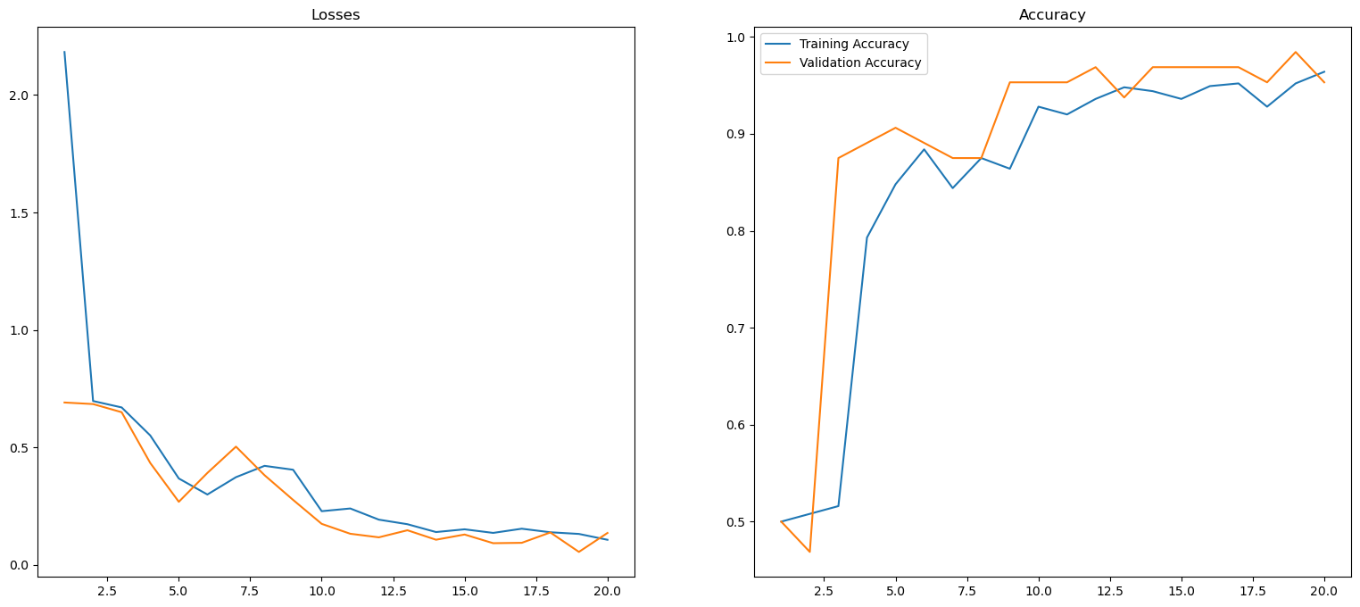
Model Analysis:-
Covid Detection Model:
Model:Convolutional Neural Network (CNN)
Accuracy:96.4%
Losses:1%

Slide 9
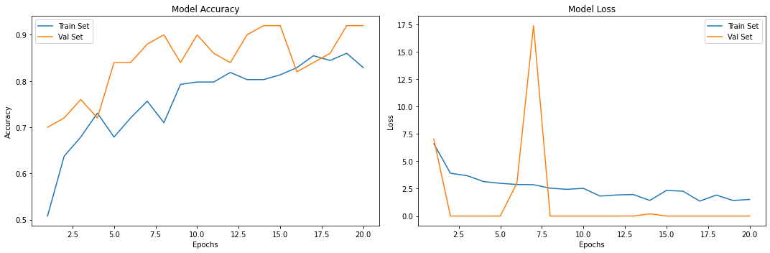
Model Analysis:-
Brain Tumor Detection:
Model:Convolutional Neural Network (CNN)
Accuracy:90%
Losses:0%

Slide 10
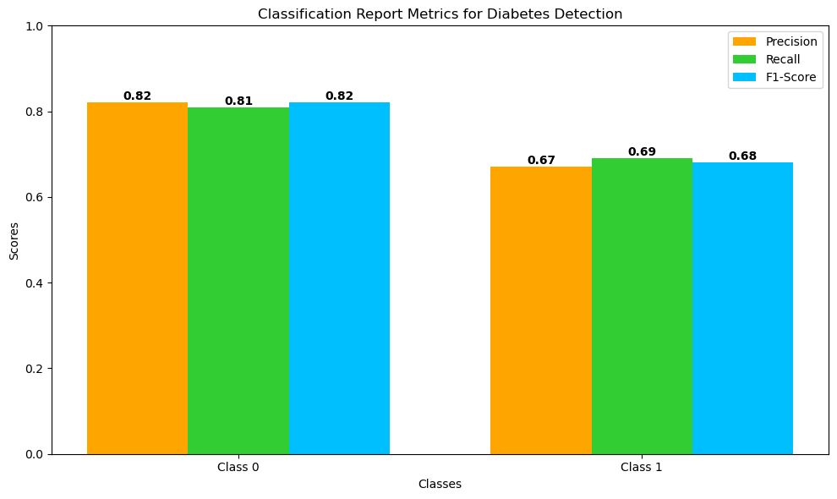
Model Analysis:-
Diabetes Detection Model:
Model: Random Forest Classifier
Accuracy : 76.62%

Slide 11
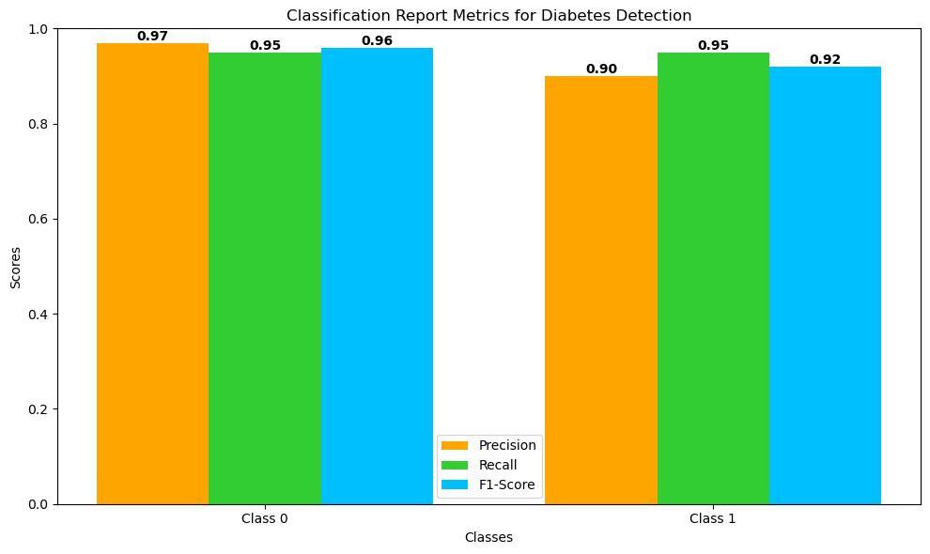
Model Analysis:-
Breast Cancer Detection Model:
Model: Random Forest Classifier
Accuracy : 94.15%

Slide 12
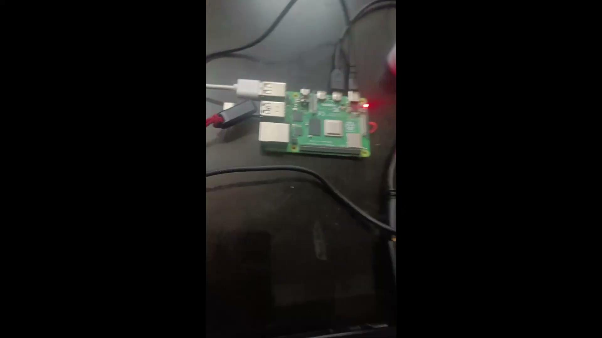

Slide 13
Tasks Completed Till Date:
Models Completed and tested successfully
Covid 19 Detection
Diabetes Detection
Brain Tumor Detection
Breast Cancer Detection
2) Synopsis completed
3) Literature Review -1
4) List of Conferences and Journals
5) Developing Main Dashboard UI
6)Hardware Setup
7)Complete Website deployment on Raspberry Pi 4

Slide 14
Conclusion:
Significant progress has been made with the successful completion and testing of key models, including the COVID-19 Detection, Diabetes Detection, Brain Tumor Detection, and Breast Cancer Detection models. These milestones represent crucial steps toward developing an AI-powered platform capable of providing fast and accurate diagnoses for critical medical conditions. The integration of these models into the unified system highlights the platform's potential to deliver comprehensive healthcare assessments. After Mid-Term Assessment, we are now even closer to realizing our goal of creating a complete diagnostic tool, reinforced by a thorough paper. Moving ahead, we will deploy these models on Raspberry Pi hardware and continue refining the unified platform.

Slide 15
References:
The below link contains all research papers referred for Literature Review
https://docs.google.com/spreadsheets/d/1HY43jncATuB54EW__IrWAHrPZ553wreMMzIMwPD8_XU/edit?usp=sharing

Slide 16


